Slide 1
Reverse Logistics and Return Merchandise Authorization

Slide 2
Background
KOKO Kenya has been using a distribution solution to manage the following:
Products at Main Warehouse
Product Availability at Agent Shops
Distribution network
The company organisation does not have a solution to efficiently manage the reverse logistics of products from customers to the main warehouse. This document covers the high level scope and business processes to provide a timeline for the reverse logistics, returns, warranty management and repairs process detailed scoping and development for KOKO Kenya.
Whenever KOKO Cookers or KOKO Canisters have any defects the organisation has an obligation under its Warranty Policy (see next slide) objective to resolve the issue efficiently in the shortest time possible by the repair or the replacements of products.
If the Products are no longer covered by Warranty, the company seeks to provide the same quick and convenient service on a paid basis to Customers to ensure that they are not interrupted in using KOKO Fuel
This document highlights the business processes and system requirements which are to be incorporated within the existing distribution solution to manage returns, repairs, warranty and customer satisfaction.

Slide 3
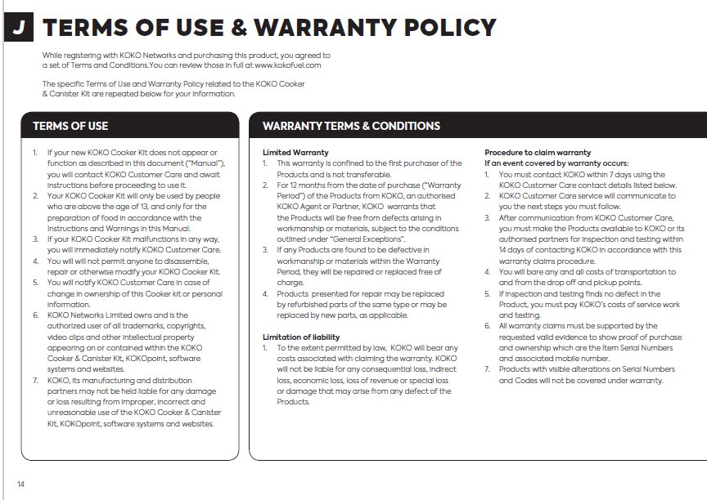
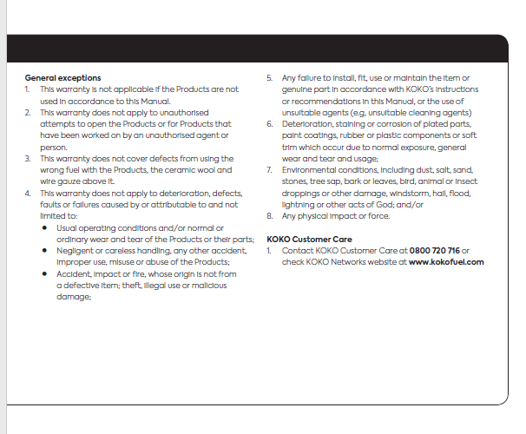

Slide 4
Stakeholders List
High Level Process / Project | Technology | Exco Sponsor | Lead Business Manager | Other Business Stakeholder
Warranty Management | Odoo KNK | Sagun / Nick | Moses Maresi
Maintenance and return Operation Network and Commission Structure | Odoo KNK, KOKO Core | Ari / Matt / Sagun? | Hezbon K’ogollah
Accounting and Finance Entries for Agent and Customer | Odoo KNK, KOKO Core | Nicholas Stokes | Smit Shir | Humphrey Mokaya / David Mwaura
Customer Care and Ticket Ticket Management | Zen Desk, Odoo RMA | Matt / Ari | Alexandra Pearson
Collection Process for Cooker by Agent | My KOKO App, Odoo | Matt / Ari | Hezbon K’ogollah
Return of Cooker | My KOKO App, Odoo | Matt / Ari | Hezbon K’ogollah
Repair Or Replacement | Odoo | Matt / Ari | Hezbon / Maureen
Dispatch Of repaired or Replaced Product | Odoo, KOKO Mile, Loginext? | Matt | Hezbon K’ogollah

Slide 5
Timelines
 |  | Scoping |  | Handover |  | Delivery
Project Entities |  | Start Date | end Date | Start Date | end Date | Start Date | end Date
Pre- Req
 | Warranty Mang | May 25,2020 | June 5,2020 | June 8, 2020 | June 10, 2020 | June 11,2020 | ---
 | MRO Network/ Commission Structure
Customer care |  | June 1,2020 | June 17, 2020 | June 18, 2020 | June 23 | June 24 ,2020 | --
Accounting And Finance |  | June 22, 2020 | June 29, 2020 | July 1, 2020 | July 03, 2020 | July 4,2020
Agent Collection and Return Journey |  | July 06,2020 | July 17, 2020 | July 17, 2020 | July 23, 2020 | July 24, 2020 | --
Warehouse Stock |  | July 27, 2020 | July 31,2020 | Aug 3,2020 | Aug 6,2020 | Aug 7,2020 | --
Service and Repair Process
Distribution

Slide 6
Reverse Logistics and RMA
Pre-Requisites

Slide 7
Warranty Management System
User Requirements:
As a Admin User in Odoo I should be able to create warranty term Master where I can specify Date when the new term was Introduced. As user I must have Option to Activate or Deactivate the Warranty term.
I would like to be able to configure the warranty terms in the Product Master. The Same will be updated on the Product Tracker when the product tracker is created.
In Product Tracker I should be able to see the warranty expiration date for the products which are sold, Based on the Product Sales date and the warranty term selected.
I must have a filter to see how many products are under warranty.
As a Customer Care Representative I would like to Validate the Information provided by the Customer Regarding the Product Serial and the Sales Date. Also would like to see the Warranty terms for the Product at the time of sales. [In case we change the warranty Term in future].
All the information must be validated from the Odoo Backend on a real time Basis and Provide the following data to the sale Rep.
Date of Sale / Fulfillment.
Warranty Term
Warranty Expiration date.
As a CC Rep I should be able to see if other tickets are created for the given serial Number.
If the Product Is out of warranty and repair cost is involved, CC Rep must be able to send quotation for the repair to the Customer on the App.

Slide 8
Warranty Management System
In warranty management system there will following components:
Need to decide the Warranty Types to be provide to the Customers.
On whole Product
On accessories
Manage Warranty on Lot Number or Serial Number, as warranty may change over time, also there should be a history managed for the Warranty Variations.
There we can set the Warranty Period for the Product (In month) eg. [12 Months, 18 months and so on]
Warranty Expiration should be auto calculated based in the Config and Invoice date. We can update the same on the Product tracker if required.
Warranty period to be recorded in Invoice? For future reference and sync to Customer Care Rep
Extended warranty for accessories?
Free service offerings?
APIs to request the data from third party software.
Update KOKO Core and ERP if any Item is Replaced.

Slide 9
Warranty Management System
Resource Requirement and Time Lines:
Process | Time required | Resource Required | Start and End Date
Scope Discussion | 7 -10 Working Days | Product Quality Team Software Product Manager | May 25 - June 5, 2020
Handover / Eng. Discussion | 2-3 Working Days | Engineering Team ERP Engineering Team KC Software Product Manager | June 8 - June 10, 2020
Delivery (Inc. UAT/User Training) |  | Engineering Team | June 11 Onwards
User Manual / Training Documentation | 2 Working Days | Software Product Manager | 2 Days ,Once Feature is Developed

Slide 10
Maintenance and Repair Agent
User Requirements:
As Odoo Administrator user should be able to perform following operations.
Mark the Agent as a Maintenance and repair Agent in Odoo.
As user I must have filter option to see the list of Maintenance agents separately.
Also User should be able to set commission which is to be given to the agent for product coming for repairs.
As a Maintenance and Repair incharge, in Odoo, I should be able to see all the repair Orders in a separate list view, Also there should have state wise filter to see New, In progress, Done orders In the list.
As a Finance User in Odoo, I must be able to see all the commission payable to the Agents for the repair Orders, And at the and of every month there must be provision to create the Consolidated bill for the Agent Commission.

Slide 11
Maintenance and Repair Agent
Functionalities to cover:
Process to Assign MRA [Maintenance and Repair Agent] in the system [ERP and KC]
Use Geolocation to show the nearest MRA available to the customer through Customer App.
Define Commission Structure for MRA in ERP.
Need to Create Repair Order for these ticket [If on a chargeable basis], and commission needs to be calculated as per the current commission management system.
ERP will generate the Commission at the end of the month [Will be recorded in Shope Monthly Statement].

Slide 12
Reverse Logistics and RMA
Customer Care

Slide 13
Customer Care Process
Functionalities to cover:
Data Collection on Customer Care System [Zendesk]
Need to add the FAQ in the system so that Customer Care rep can assist customer with predefined guidelines.
Data Validation from ERP system through APIs.
Customer and Product Serial Validation
Product Warranty Validation
Once the ticket is logged Customer should receive a SMS with ticket number and Ticket Summary
Service charge Processing:
If applicable charge user for the repair then customer approve and transaction will pass through the KOKO core and record will be created on ERP as a service order.
If customer does not have enough credits then Warning to TopUp the account.
Agent Allocation for collection:
Need a feature where consumer can find out the nearest KOKO Repair Agent and drop the product there.
When the Customer submits the product to the Agent, Customer should receive a SMS and one entry should be created in ERP in the separate table.
Show Tracking to the customer where his product has reached.
SMS to be sent as the product reaches to the Agent shop after repair, so that customer can come and collect.

Slide 14
Customer Care Process - 01
START NO
Yes
1
CC receives call customer for a defect
CC record details and proposed STD resolution
Under Warranty?
2
CC creates RMA with min required details
Communication to customer RMA code and Return Location
Copy to Stakeholders
END

Slide 15
Customer Care Process - 02
NO NO
Y
Y
NO
2
Notify Customer about Repair Cost and Get their approval on Payment
Customer ready for Parts Cost
Partial
Warranty?
CC creates RMA and notify estimated cost
Communication to customer RMA code and Return Location
Copy to Stakeholders
Payment done?
Odoo validates RMA with relevant payment confirm ID and service team notified
Repair Cost deduction from Customer Wallet (MyKOKO)
END

Slide 16
Customer Care Process
Resource Requirement:
Process | Time required | Resource Required | Start and End Date
Sope Discussion | 12-15 Working Days | Customer Care team Distribution Team Trip Manager Software Product Manager | June 1 - June 17, 2020
Handover / Eng. Discussion | 3-4 Working Days | Engineering Team ERP App Team KOKO Core Team Software Product Manager | June 18 - June 23, 2020
Delivery (Inc. UAT/User Training) |  | Engineering Team | June 24 Onwards
User Manual / Training Documentation | 2 Working Days | Software Product Manager | 4 Days ,Once Feature is Developed

Slide 17
Reverse Logistics and RMA
Accounting And Finance

Slide 18
Accounting and Finance
User Requirements:
As a finance user I should be able to create Contract for the Maintenance Agent and the select the agreed commision type in the contract.
As a user should be able to View the Repair / Service Orders for the customers and the invoice created for the same.
Finance user should be able to configure the payment configuration for the Service order. [Payment will be done when customer will approve the quotation for service order / repair]
Finance user should be able to define Tax Structure for the services if any and for the products which will be replaced as well..
As a Finance User in Odoo, I must be able to see all the commission payable to the Agents for the repair Orders, And at the and of every month there must be provision to create the Consolidated bill for the Agent Commission.

Slide 19
Accounting and Finance
Functionalities to cover:
Customer Invoicing Process:
Invoice Creation of the service order if approved by the customer.
Service Charge deduction from the customer account on a prepaid Basis.
Defining the Service types and the Products and the create Invoice Configuration for the same.
Define Tax Structure for the services.
MRA [Maintenance and Repair Agent] Billing:
Need to discuss the process for the Agent Contract creation and Commission for the MRA.
Need to understand the Commission structure:
Unified for all the Items.
Different for each specific item.
Need to Add the process for creating the Bill for the Vendor at the end of the Month and Processing the Payment.
All the commission collected will be added in the SMS [Shop Monthly Statement] as well. And all MRA Commission Line must be added in the SMS.

Slide 20
Accounting and Finance
Resource Requirement:
Process | Time required | Resource Required | Start and End Date
Sope Discussion | 12-15 Working Days | Customer Care team Distribution Team Trip Manager Software Product Manager | June 22 - June 29, 2020
Handover / Eng. Discussion | 3-4 Working Days | Engineering Team ERP App Team KOKO Core Team Software Product Manager | July 1 - July 3, 2020
Delivery (Inc. UAT/User Training) |  | Engineering Team | July 4 Onwards
User Manual / Training Documentation | 2 Working Days | Software Product Manager | 4 Days ,Once Feature is Developed

Slide 21
Reverse Logistics and RMA
Agent Collection and Return Journey

Slide 22
Agent Collection and Return Journey
Functionalities to cover:
Collection Process:
Customer App Changes:
Need to show the nearby MRA in the app, based on geolocation.
Integration with Google Map API to show the Path to the nearest MRA Agent
Service Order tracking notifications
Agent Application:
UI design and mockups
Agent Login.
Agent can scan the products they receive from the Customers for repair.
This will trigger the API and create Stock moves in Odoo. So that the Inventory on the agent location is managed.
Also we can show all the necessary information of Agent in the App.
KOKO Mile App Changes:
UI design and Mockups.
Provision to scan the Item and Loading in the Vehicle from the agent shop.
Unloading process for faulty product transfer to the repair location.

Slide 23
Agent Collection Process - 01
START
Customer take product to Agent/Return Location notified by CC
Product Scan/RMA
Valid?
Yes
03
NO
Communication to customer (MyKOKO) and Stakeholders (KC)
Yes
Customer calls CC and confirm RMA details
No Valid RMA?
Agent verifies RMA/Customer details with Product Code (KC)
Trigger Return Order to Odoo ref to RMA
(KC to Odoo Sync)
MRO Agent confirms Product Return (KC)
NO
END

Slide 24
Return Journey/Collection Process - 02
03
Loginext optimize and planne collection trip and sync to Odoo
Yes
Return Order triggered in Odoo in Draft state
Agent >> MSW/Stock
Loginext for Plan Collection Trip?
No
Confirmed Trip load into KOKOMile App. Driver Starts Trip
Driver reach Agent Location. Scan products to confirm pick up KOKOMile App
Collection Trip in Odoo
Collected Products dropped in at KOKO WH (KOKO Mile/Odoo)
Return Order in Odoo Validated and Products Scanned to KOKO WH
Received Product moved to Service Location (Internal Transfer in Odoo)
Service Teams starts inspection
Communication to customer (MyKOKO) and Service team (Odoo)
04

Slide 25
Agent Collection and Return Journey
Distribution:
SD Trip Object Changes:
Trip and Route Planning, so that we can deliver and Collect the product in a single trip.
In SD trip We need to add another tab for the Pickups scheduled for the day.
It to add the Repair Orders in the trip along with the Shop Order so that the Repaired product can be delivered to the end users on time.
Customer Location
Agent Location
Intransit Location
Repair Location
Agent Location
(Customer to collect)
Intransit Location
Service Repair completes
Product Journey for Repair Process

Slide 26
Agent Collection and Return Journey
Resource Requirement:
Process | Time required | Resource Required | Start and End Date
Sope Discussion | 12-15 Working Days | Agent Sales Team Distribution Team Trip Manager Software Product Manager | July 6 - July 17, 2020
Handover / Eng. Discussion | 3-5 Working Days | Engineering Team ERP App Team KOKO Core Team Software Product Manager | July 17 - July 23, 2020
Delivery (Inc. UAT/User Training) |  | Engineering Team | July 24 Onwards
User Manual / Training Documentation | 4 Working Days | Software Product Manager | 4 Days ,Once Feature is Developed

Slide 27
Service Repair Process
Functionalities to cover:
Once we have the service order created in the system, Use the CRR V1 Functionality to perform the repair.
If there would be any changes required as per the new scope will make the changes.
We will have to change the stock transfer process as per the new flow.

Slide 28
Reverse Logistics and RMA
Warehouse and Stock

Slide 29
Warehouse Stock
User Requirements:
Setting Up Min / Max Stock Levels, Lead Time, Auto RFQ Creation:
In Present Business Process in KOKO we have not started procuring the Spare Parts for Kits and Canisters.
Need to Estimate the requirements for the spares and setup the Reordering rule for the Same.
Need to estimate the approximate Lead time for the Items to reach Warehouse from India and set up the same in the system along with some required reminders and notifications based to take appropriate action on time.
Also If required, We can also setup auto RFQ creation of the Spare Items based on the Minimum Quantity set in the reordering rules. And the same can be approved and processed further.
Stock Request, Issuance and Return:
In current system system user do not have any provision where they can request stock form the warehouse and use them for Repairs.
Need to Provide a Process where repair staff can request for required items in the repair location, which can be used in the repairs, If the repair people find any issue in the Stock, they will have option to Return the Product to the stock location or scrap them.
This process will provide control on the Repair stock and the requester will be responsible for any issue in the data.

Slide 30
Warehouse Stock
Stock Request, Issuance and Return:
Request Stock in Service Location
Request approved
Stock Issued to the Repair Shop
Stock OK
Stock tested Ok and In desired quantity.
Stock returned to the warehouse initiated and Processed
Stock Consumed In Process
Close
Close

Slide 31
Warehouse and Stock
Resource Requirement:
Process | Time required | Resource Required | Start and End Date
Sope Discussion | 3-5 Working Days | Warehouse Team Repair Team Software Product Manager | July 27 - July 31, 2020
Handover / Eng. Discussion | 2 Working Days | Engineering Team ERP App Team KOKO Core Team Software Product Manager | Aug 3 - Aug 6, 2020
Delivery (Inc. UAT/User Training) |  | Engineering Team | Aug 7 Onwards
User Manual / Training Documentation | 2 Working Days | Software Product Manager | 4 Days ,Once Feature is Developed

